Slide 1
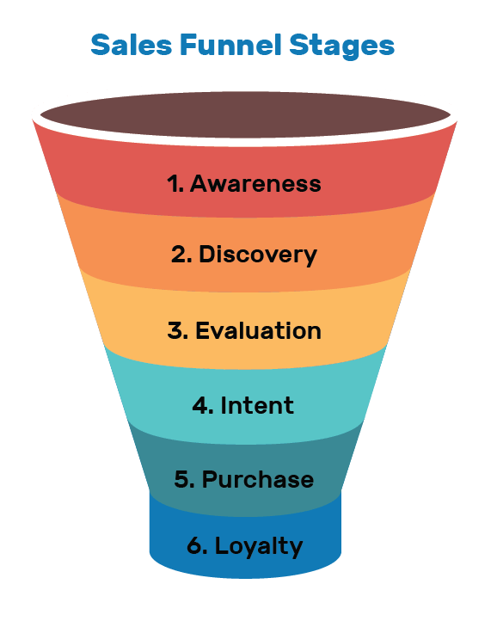

Slide 2
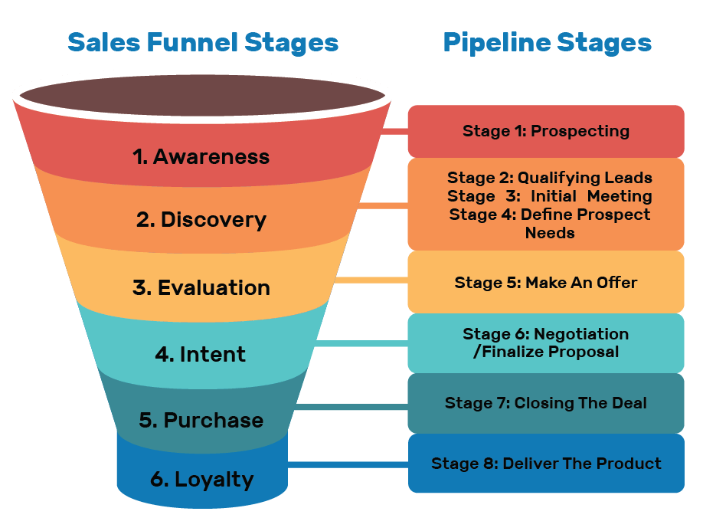

Slide 3
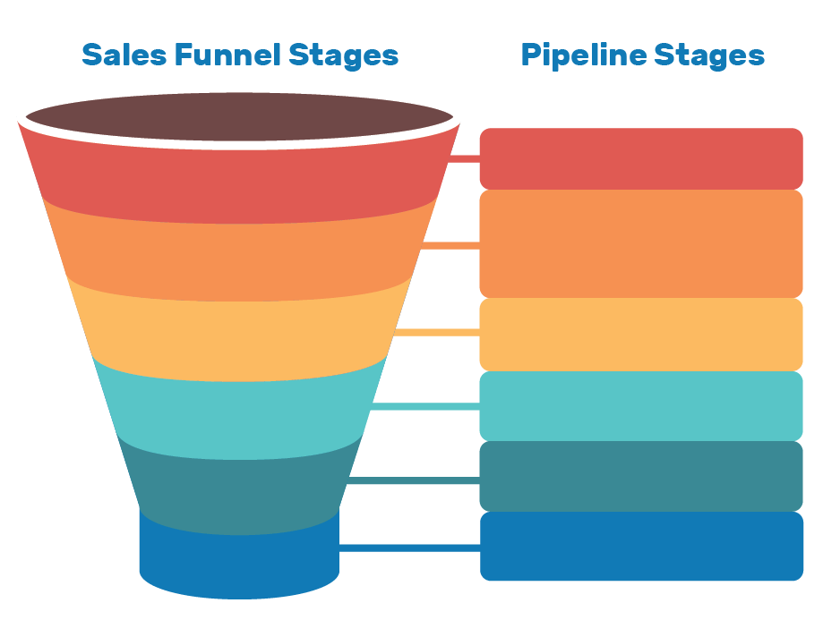
1. Prospecting
Sales Activities:
1. Awareness
Sales Activities:
2. Qualifying Leads
3. Initial Meeting
4. Define Prospect Needs
Sales Activities:
2. Discovery
Sales Activities:
3. Evaluation
Sales Activities:
5. Make An Offer
Sales Activities:
4. Intent
Sales Activities:
6. Prospecting
Sales Activities:
5. Purchase
Sales Activities:
7. Closing The Deal
Sales Activities:
8. Deliver The Product
Sales Activities:
6. Loyalty
Sales Activities:
Notes:
Use this template to create your own sales funnel and corresponding pipeline stages

