Slide 1
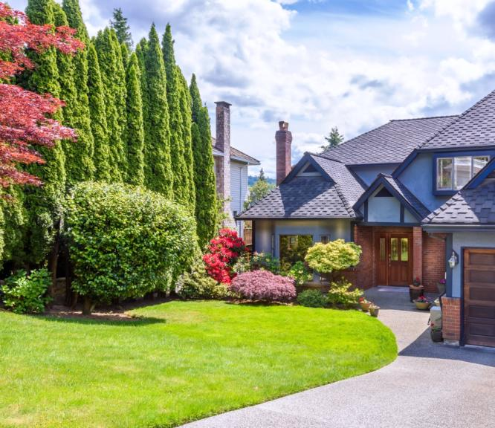
Listing Address
Listing Presentation for:
PRESENTED BY:

Slide 2
About [Your Name Here]
Mini resume
Education
Statistics and figures:
The number of homes you’ve sold in their area in the past year
Types of homes you’ve sold if they’re similar to theirs (include a picture, if applicable)
How quickly you’ve sold homes listed with you (average days on market, if favorable)
Closing prices compared to list prices (did you get over-asked and by how much?)
Awards, designations, and so forth
Hobbies/interests
Your promise
Your value

Slide 3
About [Brokerage Name Here]
General company info (time in business, how many agents, location expertise)
Statistics and figures (how many homes sold, median sales price, and so on)
Awards, designations, and so forth

Slide 4
Enough About Me,
Let’s Focus on You
When do you need to move by?
Why are you moving?
Where are you moving to?
Have you already found a home there?
Is getting a good price or timing more important for you?
What will you do if your home doesn’t sell?
What are you looking for in a listing agent?
How much is left on your mortgage?
Are there any liens on the property?
Are there any issues with the home that we won’t see today?

Slide 5
Local Market Data Overview
Homes sold in past year
Homes on market currently
Median sales price in past year
Average days on market in past year
[Feel free to include graphs/charts here]

Slide 6
The Sales Process (in a nutshell)

Slide 7
7 Steps to
Sell Your Home

Slide 8
1
Prepare Home to Sell
Decluttering
Depersonalizing
Cleaning
Repairs
Renovations

Slide 9
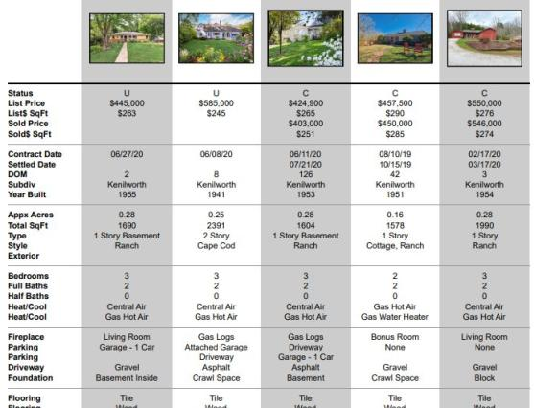
2
Determine Listing Price
What is a comparative market analysis (CMA)?
What is the purpose and what it entails
Items that will contribute to the CMA report:
Square footage
Updates
Number of bedrooms and bathrooms
Current market trends that affect pricing
Sample CMA Report

Slide 10
3
Effectively Market the Property
HD Photography & Videography
We will showcase your home with large, HD-sized images. Potential buyers can quickly view the gallery or tap for full screen imagery.
Different buyers like different kinds of listing media. We provide all kinds to appeal to all buyers.
Home Staging
Intentionally prepare a home’s furnishings, art, and overall appearance to appeal to specific real estate buyers and let them envision themselves living in the property.
Direct Marketing
Incorporate traditional marketing strategies, like sending postcards, direct mail, and host an open house to capture more leads.
All content, including videos, brochures and more, are published on a dedicated website for your home and distributed throughout the internet.

Slide 11
Advertise on Major Platforms
4
We help you stand out from the crowd to sell quickly, efficiently, and for the most amount of money.
Local Multiple Listing Site (MLS)
Internet Platforms
04
01
03
Website and Landing Pages
Social Media Platforms
02

Slide 12
5
Showings &
Open Houses
Determine times/dates for open houses
Discuss access to property that comfortably suits your schedule
What I will do during open houses and showings

Slide 13
6
Offers & Negotiations
Gather offers and present them to you
Discuss advantages and disadvantages of each offer
Set guidelines for bottom line (amount of money you feel comfortable with)
Determine offers to reject, counter, or accept
I will be the communication liaison between you and the sellers/seller’s agent

Slide 14
7
Closing & SOLD!
Add picture
Organize and keep you informed during:
Appraisal
Inspection
Financing
Other contingencies encountered
Get to closing table and finalize transaction

Slide 15
My Contact Information
Name:
Phone:
Email:
Website:

